Slide 1
The Data Cards Playbook
A toolkit for purposeful and people-centric dataset documentation for transparency in AI systems.
https://pair-code.github.io/datacardsplaybook/ #datacardsplaybook

Slide 2


Introduction
01 Ask 02 Inspect
03 Answer
04 Audit

Slide 3
Your Data Card Brief
Facilitator’s note
This is a basic activity for teams that do not have a clear brief, PRD, or Vision for their Data Cards efforts.
Delete this note once you’re done with it.
THE DATA CARDS PLAYBOOK
Define the scope, values, and vision for your Data Card(s) effort.

Slide 4
Through a series of critical reflections and discussions, decide how Data Card(s) might help your datasets’ and transparency goals.
A brief that describes why you’re creating Data Card(s), what success looks like, and what’s out of scope.
Basic

Slide 5

Consider the following types of dataset documentation:
Facilitator’s note
This is a concept slide. These set the stage for activities and ensure that everyone in the room has the same level of understanding and a shared vocabulary.
Shape and size of data, pipelines, access, licenses. Context and information that can be easily acquired from the data.
Documentation ++ Processes, rules, rationales that shape the data. Context and information that cannot be learned from the data.
Transparent documentation intentionally written for humans and required for making responsible decisions about dataset use.
Observable
Explainable
Understandable
UTILITARIAN DOCUMENTATION
TRANSPARENT DOCUMENTATION
RESPONSIBLE DOCUMENTATION

Slide 6
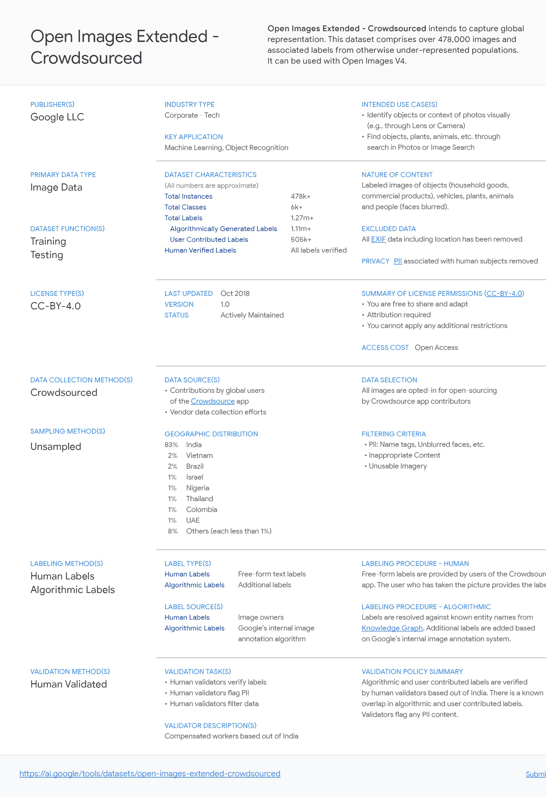
Data Cards summarize critical information about datasets that help people to make informed decisions about how data is used in ML systems for product, policy, and research.
Translate your definition of transparency into the scope and utility for Data Cards.
OPEN IMAGES EXTENDED - CROWDSOURCED DATA CARD ↗

Slide 7
As a group, answer the following questions:
Facilitator’s note
Reframe these questions more appropriately to reflect the context of your datasets, data cards initiative, or workshop objectives.
Delete this note once you’re done with it.
What are the top 3 goals of your dataset(s)?
What are the top 3 goals of your Data Card(s)?
3 circumstances that describe the experience of transparency that your Data Card(s) should deliver?
3 circumstances in which your Data Card(s) are a wasted investment?

Slide 8
What are the top 3 goals of your dataset(s)?
Consider: What motivates you to create them? What does success of your dataset look like? Is it adoption or purchase? Improvement of production systems? Furthering a research agenda?
5
min
✍️
2. ✍️
3. ✍️

Slide 9
What are the top 3 goals of your Data Card(s)?
Consider: How does the goal of your Data Card support the goals of your dataset(s)? How must a Data Card be used so that it contributes to the success of your dataset(s)?
5
min
✍️
2. ✍️
3. ✍️

Slide 10
3 circumstances that describe success for your Data Card(s)?
Think about your own experience of transparency, the experience of using dataset documentation, and successful outcomes of transparency in data.
5
min
✍️
2. ✍️
3. ✍️

Slide 11
3 circumstances in which your Data Card(s) are a wasted investment?
Consider obvious and mundane tasks, or easily preventable failures of Data Cards. What type of documentation included in a Data Card might make it worthwhile?
5
min
✍️
2. ✍️
3. ✍️

Slide 12
Your Data Card Brief
15
min
Facilitator’s note
This will be the true north for your Data Cards work.
If this is predetermined, skip previous sections and walk participants through a detailed brief to prevent swirl.
Delete this note once you’re done with it.
By using Data Cards, we hope to…
✍️ short statements that describe major use cases, objectives and value of Data Cards
Successful Data Cards look like …
✍️ explicit statements for measuring the success of implementing Data cards, telling us if they have met our objectives.
Non-goals of Data Cards are…
✍️ statements about what has been purposefully excluded from your Data Card efforts, and things that should not be related.

Slide 13
Checklist
YOU SHOULD NOW HAVE DEFINED
_
The goals and objectives of your dataset(s)
The goals and objectives of your Data Card(s)
What’s in scope and out of scope for your Data Card(s)
When your Data Card(s) do not work
✔
✔
✔
✔

Slide 14

#datacardsplaybook
The Data Cards Playbook ↗ is an adaptable toolkit of participatory activities, conceptual frameworks, and guidance that support Responsible AI practices for transparency in dataset documentation.
If you’ve adapted, implemented, or have feedback for this guidance, we’d love to hear from you at https://github.com/pair-code/datacardsplaybook ↗.
Find the complete playbook at https://pair-code.github.io/datacardsplaybook ↗

Slide 15

The Data Cards Playbook ↗ by the People + AI Research Initiative ↗ at Google Research ↗ is licensed under a Creative Commons Attribution-ShareAlike 4.0 International License. You are free to share and adapt this work under the appropriate license terms ↗.

